Slide 1



Ticket To Tech
Group Members: Carrie Houston, Makenzie
Kadjeski, & Jeny Thomas

Slide 2
Problem Overview
Problem:
  Finding Optimal Path to Classes
Algorithms Implemented in Python & C++:
  Breadth First Search (BFS)
  Depth First Search(DFS)
  A* Search
  Bidirectional Search
The goal is to find the most efficient algorithm to solve this problem.

Slide 3
Objective & Research:
Objective: Determine which algorithm is the most efficient for finding the optimal path between two places.
Time complexity :
  BFS, DFS, and A*: O(|n|²)
  Bidirectional: O(|b|^{d/2} )
Expected Results: Bidirectional will be the most efficient algorithm

Slide 4
Description of Experiment:
Real World Datasets of Tennessee Tech’s Campus
  Small, medium, & large unweighted graphs
Tested code on Makenzie’s MacBook Pro five times for:
  Each algorithm on each graph
  Brute force on small and medium graphs
Routes we tested
Comparisons
Notes:
Real World Datasets of Tennessee Tech’s Campus
Small, medium, & large unweighted graphs
Tested code on Makenzie’s MacBook Pro five times for:
Each algorithm on each graph
Brute force on small and medium graphs
Routes we tested
Ashraf Islam Engineering Building to Roaden University Center (RUC)
Bruner to RUC
Library parking lot to Bell Hall
Comparisons:
Extra Vertices vs. Execution Time
Graph size vs. Farthest Point Execution Time
Brute Force

Slide 5
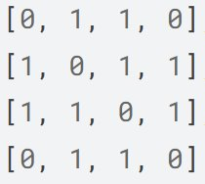
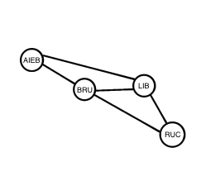
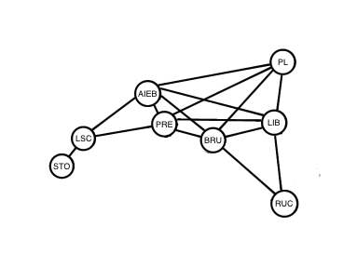
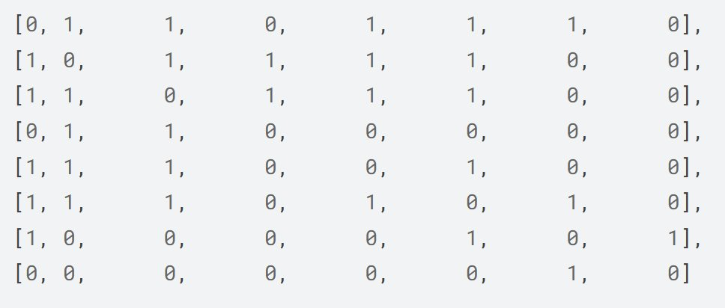
Input Matrices and Graphs

Slide 6
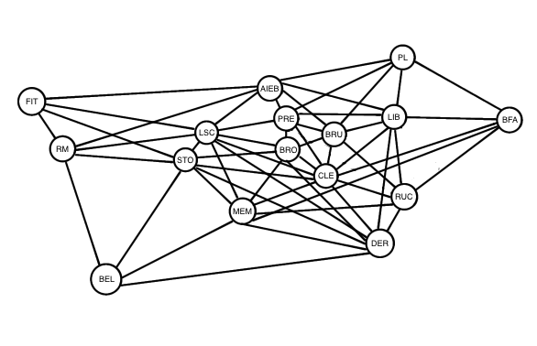
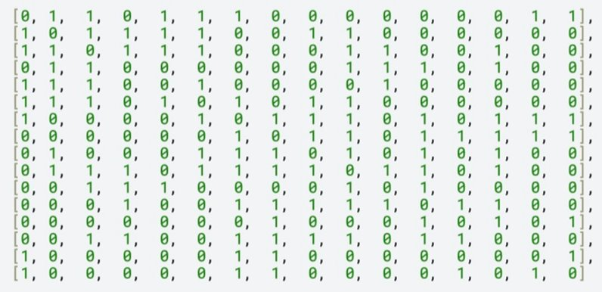
Input Matrices and Graphs

Slide 7
Results:
Execution times ranked from lowest to highest:
  Bidirectional
  DFS
  A*
  BFS
Most consistent algorithms:
  BFS
  Bidirectional

Slide 8
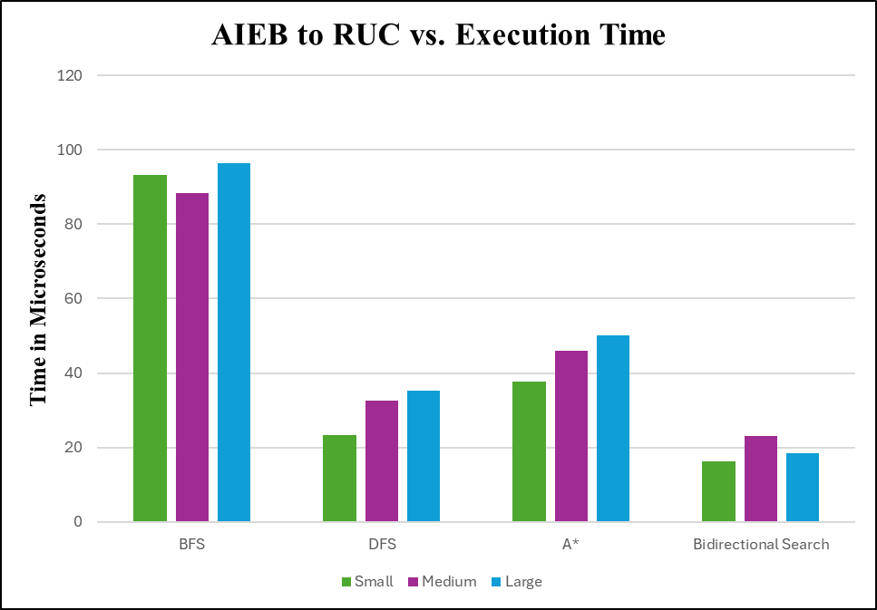
Figure 1 and Table 1

Slide 9
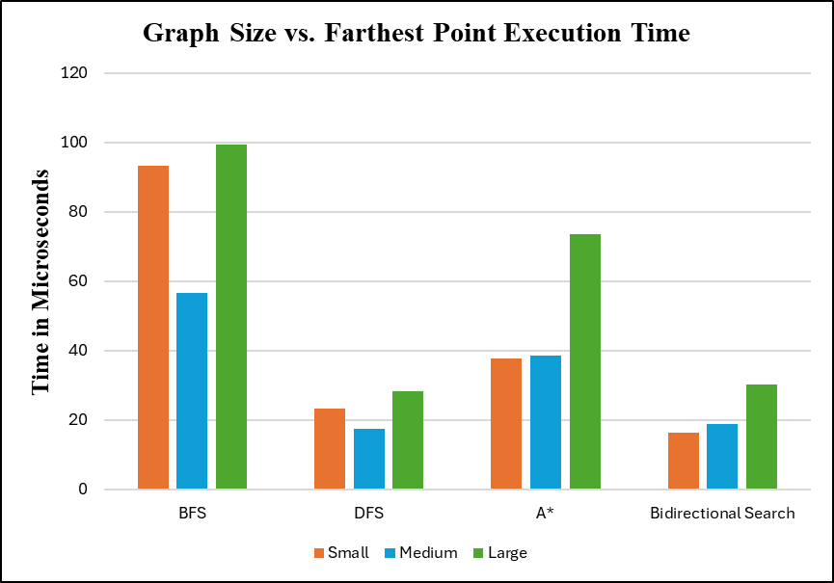
Figure 2 & Table 2

Slide 10
Table 3:

Slide 11
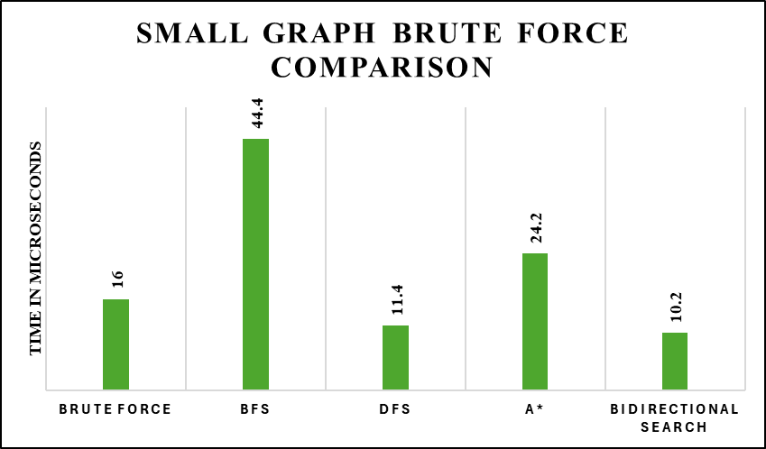
Figures 3 & 4

Slide 12
Interpretation Summary:
Ran the program 5 times per input
Larger number of vertices → longer execution times
Bidirectional was most efficient when searching for the path between the furthest points; BFS was least efficient
Brute force is most efficient with small input sizes
Notes:
Brute force couldn't be tested in the large graph because it took forever compared to other algorithms, first trial for large graph was 40,000,000 microseconds (40 seconds)! And execution time was increasing with every trial.

Slide 13
Limitations & Next Steps:
Limited input size, graph structure, limited time
Larger input size, sparser graph, implement a weighted graph, measure different outputs
Notes:
Limited input size, dense graphs due to real data (buildings are close together), didn’t have time to test as much as a normal experiment should've, could've made larger input sizes
Larger input size, only mark an edge if you can go from door to door, the distance between each building is the weight of the edge between them, maybe don’t measure the execution time but the shortest path or smallest "weighted" path

Slide 14

QR Code:

Slide 15
References:
GeeksforGeeks. (2008). GeeksforGeeks. https://www.geeksforgeeks.org/ -used in objective/research
Kumar, Rajesh. (2024). DataCamp. The A* Algorithm: A Complete Guide |DataCamp
Levitin, A. (2012). Introduction to the design & analysis of algorithms. Pearson. -used in objective/research
OpenAI. (2025). ChatGPT [Large language model]. OpenAI. https://chat.openai.com -experimentation
Radian, C. (2025). Section 3.5 DFS_BFS Presentation. -used in objective/research

